Slide 1
Making Every Minute Count
Tactical Scheduling Tips for Administrators

Slide 2
Presented by: Ms. Carrie Sanchez
Former Principal ~ Port Clinton Middle School
President ~ Ohio Association of Elementary School Administrators
Director of Leadership & Learning ~ North Point Educational Services Center
Adjunct Instructor ~ Bowling Green State University in the Graduate School of Teaching and Learning

Slide 3
“Well we cannot do THAT !”
Please raise your right hand and solemnly promise to YOURSELF that for the next hour you will not fall into the default mindset of:
“Well we cannot do THAT !”

Slide 4
Let’s have some fun!
I love talking with people about this stuff!

Slide 5
It would be awesome if you had a Master Schedule that:
Was developmentally appropriate for students
Used every available minute for purposeful instruction
Allowed for daily collaboration time between teachers
Allowed for daily personal plan time for teachers
Did not require teachers to have duty periods
Offered a rich variety of elective courses
Was flexible for special events & assemblies
Supported purposeful instruction time even during delays and testing
AND…
Was compliant with every negotiated agreement in your district!

Slide 6
It is not impossible.
It DOES exist.

Slide 7
Mindset

Slide 8
First:
Think about what you would like to accomplish with your Master Schedule

Slide 9
((…thinking))

Slide 10
What is something you would like to accomplish?
Anyone brave enough to share?

Slide 11
Now think about why your current Master Schedule is different from your DREAM schedule

Slide 12
((thinking…))

Slide 13
Please share your obstacles & barriers!
I promise you aren’t alone!

Slide 14
Is the answer outside the window?
Or in the mirror?

Slide 15
John Maxwell:
“If you suck in your stomach when you look in the mirror, just who exactly, are you trying to deceive?”

Slide 16
School leaders must take ownership of this key element of school operations.
OWN IT

Slide 17
Creative scheduling begins with:
Mindset

Slide 18
Your perspective as the school leader is unlike anyone else in the school. If you are facing resistance, help others see things from YOUR (holistic) perspective.

Slide 19
“Sacrifice is an investment in success” ~ Dave Ramsey

Slide 20
What are you willing to sacrifice for the success of your school?

Slide 21
Non-negotiable facts:
Your students have to eat lunch
Your teachers have to eat lunch
Your teachers have to plan their instruction
Your district has negotiated agreements
Other than those…the clay is YOURS TO MOLD

Slide 22
First & Foremost
Define your priorities
(take a moment and write a few down!)

Slide 23
You cannot reach a goal you have not defined.

Slide 24
Port Clinton Middle School Priorities
Developmentally appropriate instruction
Common planning time for ALL teachers
Independent planning time for ALL teachers
Electives are as important as core instruction
Teachers are readily available to parents/caregivers
Every minute is used purposefully
Teachers have the freedom to use the minutes as they see fit to meet the instructional needs of their classrooms & teams

Slide 25
Port Clinton Middle School Priorities…
#1 Priority = Teaching & Learning
Above all else…Teaching and Learning is what we do.

Slide 26
Here we go-o-o!

Slide 27
Nuts & Bolts:
The average school day is 7 hours long.
That is 420 minutes.
How do you want to USE every single one of those minutes?

Slide 28
Nuts & Bolts
10 period schedule
Three schools operating within the school building
No bells <<< - read that again!
Three grade level teams & each grade level team consists of:
2 Language Arts Teachers
2 Math Teachers
1 Science Teacher
1 Social Studies Teacher
1 Intervention Specialist
(don’t worry - I’m going to show you more! )

Slide 29
More Nuts & Bolts
90 Minutes Language Arts
90 Minutes Mathematics
45 Minutes Science
45 Minutes Social Studies
45 Minutes Elective #1
45 Minutes Elective #2
30 Minutes Intervention
+30 Minutes Lunch
420 (Instructionally Rich Day!)

Slide 30
One of the biggest questions I hear:
“But what about the transition minutes?!?!?!”

Slide 31
“What you permit, you promote” ~ Tim Kight

Slide 32
Example of a 6th Grade Team Schedule
 | 1 | 2 | 3 | 4 | 5 | 6 | 7 | 8 | 9 | 10
 | Elective 1 | Elective 2 | Period 1 | Period 2 | Period 3 | Period 4 | Lunch | Anchor | Period 5 | Period 6
6th Grade Team
 | Fleet Plan | Pers Plan
Mrs. Smith |  |  | Lang Arts | Lang Arts | Lang Arts | Lang Arts |  |  | Lang Arts | Lang Arts
Mrs. Miller |  |  | Lang Arts | Lang Arts | Lang Arts | Lang Arts |  |  | Lang Arts | Lang Arts
Mr. Zimmerman |  |  | Math | Math | Math | Math |  |  | Math | Math
Miss Carlyle |  |  | Math | Math | Math | Math |  |  | Math | Math
Mrs. Williams |  |  | Science | Science | Science | Science |  |  | Science | Science
Mr. James |  |  | Soc Stu | Soc Stu | Soc Stu | Soc Stu |  |  | Soc Stu | Soc Stu
Mr. Conner |  |  | Int Spec | Int Spec | Int Spec | Int Spec |  |  | Int Spec | Int Spec

Slide 33
Example 6th grade Electives by Teacher
 | 1 | 2
 | Grade 6-1 | Grade 6-2
Electives Team
Mrs. Nitz | Phys Ed | Phys Ed
Mr. Davis | Art | Art
Miss Zuski | Work&Fam | Work&Fam
Mr. Auk | STEM | STEM
Mr. Kane | Computers | Computers
Miss Phyllis | Core Cla | Core Cla
Mr. Carr | Health | Health
Mrs. Ringer | Band | Band
Mr. Murastic | Db. Lesson | Orchestra
Mrs. Well | Choir
Mrs. Palacio

Slide 34
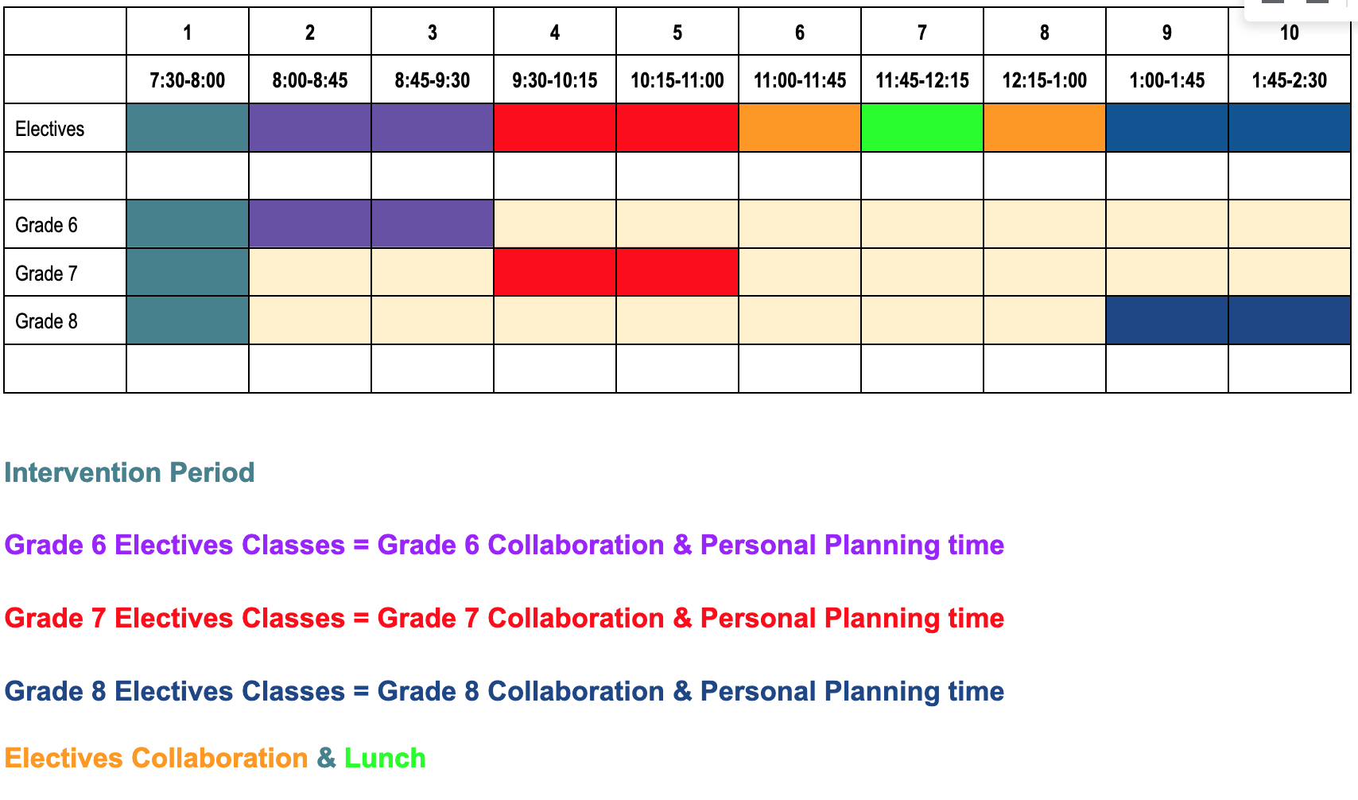
Example schedule 6, 7, and 8 with electives

Slide 35
Example of schedule by periods with Midships team and two-hour delay

Slide 36
Example of schedule by periods with Fleet 7 team and delay

Slide 37
But wait! There’s MORE!!

Slide 38
Rotating Schedule
Period 1 Period 2 Period 3 Period 4
Week 1 Lang Arts Math Science Soc Studies Week 2 Math Science Soc Studies Lang Arts Week 3 Science Soc Studies Lang Arts Math

Slide 39
A Rotating Schedule
Helps keep students engaged
Meets the needs of students with medication challenges
Meets the needs of students with extreme medical issues
Helps teachers see students in different perspectives
Keeps things ‘fresh’ for teachers

Slide 40
Key Considerations:

Slide 41
Effective Collaboration requires these five fundamental elements:

Slide 42
TEACH staff how to use collaboration time

Slide 43
Do NOT waste time

Slide 44
Set expectations BEFORE they become emotional events

Slide 45
Establish internal leadership early

Slide 46
Design meaningful communication across teams

Slide 47
Questions & Discussion

Slide 48
Thank You! Ms. Carrie Sanchez
Director of Leadership & Learning ~ North Point ESC
Email: csanchez@npesc.org
carriesanchez.com
Office: 419-627-3930 Cell: 419-341-5245
@carriejsanchez

